Slide 1
Data Platform as a Service
Presenter: Adriel
Date:11 March 2026

Slide 2
Why a data platform exists ?
System purpose
After
Before
Data Warehouse

Slide 3
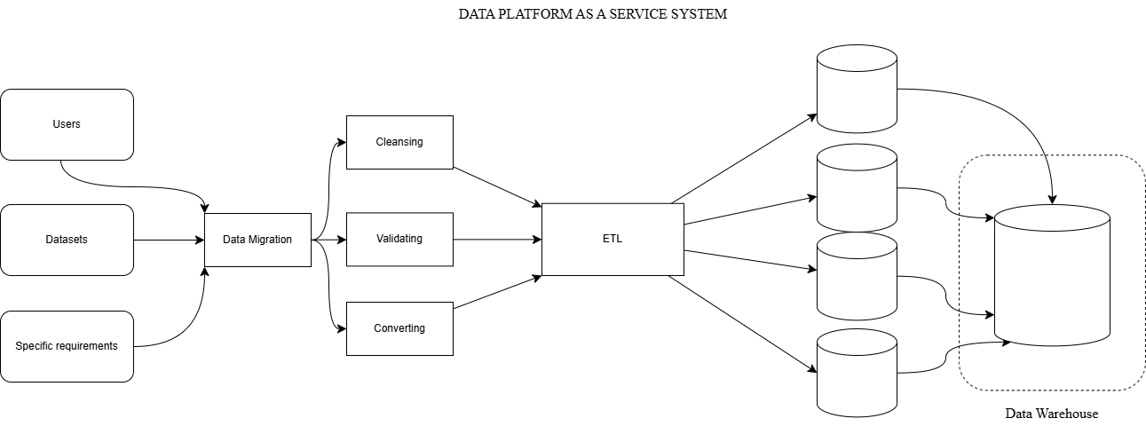
Architecture and System Scope:

Slide 4
How data entering the platform ?
Batch / stream / API
Kafka

Slide 5
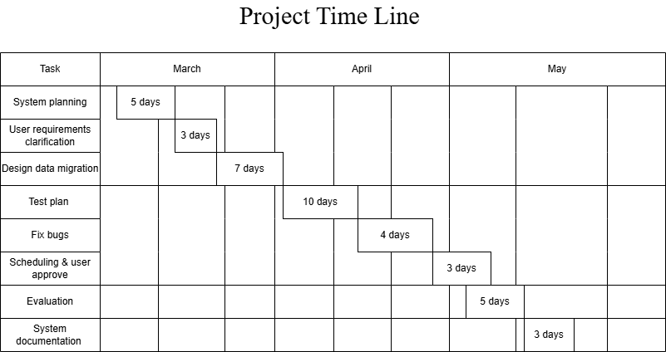
Gantt chart

Slide 6
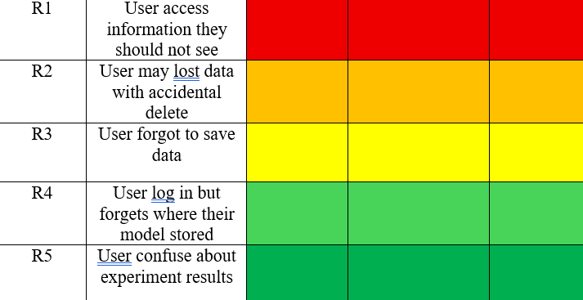
Risk Assessment matrix

Slide 7
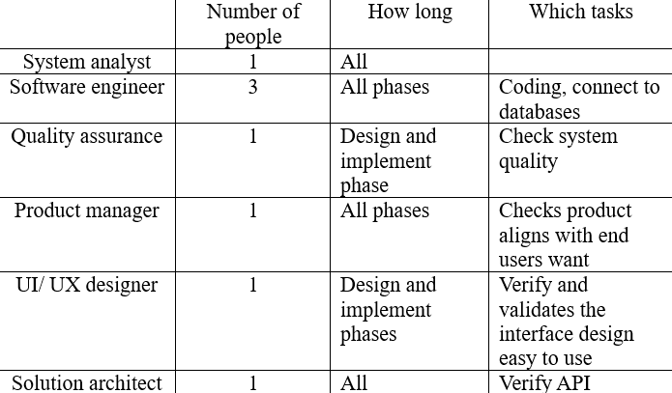
Resource Planning

Slide 8
System testing
Test scope:
TC1: Dataset CRUD
Upload or either add dataset
View dataset
Changes dataset
Delete the dataset from the system
TC2: Creates new experiment
Validates user if they want to select new experiment
Validate if users have logged in to the system and user has enough space to start
Let user continue if they have met the training specifications, otherwise they will be unable to run new experiment since the environment does not have enough memory

Slide 9
How can data become useful to end users ?
Opens and run successfully when cloning git
User can describe, use and process the dataset
Access the system after logging and training
Post implementation review criteria
Fix bugs
Checks database consistency
Maintain low memory
Users can clean their dataset
Users can integrate datasets and save it to a database.

Slide 10
How business uses the data ?
Integrate with these use cases:
APIs
Data analysis
BI dashboards

Slide 11
Takeaways:
How business operates relates to data platform ?
What can we update to improve in the future ?

